Slide 1
After the Election: SB2 and Redistricting
Paul Miles, Associate General Counsel
Nanette Forbes, Legislative Manager
Texas Association of Counties

Slide 2
Questions? Give us a ring!

Slide 3
Notes:
Do we have a stock image of a person with their head down on their desk?

Slide 4
Major Components of S.B. 2
Lowers the tax rate a county can adopt without voter approval and requires mandatory election to go above the lowered rate
Enhanced transparency and “Truth-in-Taxation” modifications
Appraisal reforms

Slide 5
New Terminology
Effective Tax Rate
No-New-Revenue Tax Rate
Rollback Tax Rate
Voter-Approval Tax Rate

Slide 6
In a Nutshell…
Pre S.B. 2
Post S.B. 2
If county adopted a tax rate exceeding the rollback rate (8 percent M&O growth), voters COULD petition for a rollback election.
Rollback election not held on uniform election date.
If county adopts a tax rate exceeding the voter-approval rate (3.5 percent M&O growth, plus “unused increment rate”), county MUST hold an automatic election.
Tax rate approval election must be held on November uniform election date.

Slide 7
Special Taxing Units
Hospital Districts
Junior College Districts
Any taxing unit, other than a school, with a tax rate less than 2.5 cents per $100
Special taxing unit keeps an 8 percent voter-approval rate

Slide 8
Voter-Approval Rate Calculation (non-special taxing units)
No-New-Revenue M&O x 1.035
Debt Service Tax Rate
Unused Increment Rate
Voter-Approval Rate

Slide 9
Unused Increment Rate
A new component in the voter-approval rate formula
The 3-year rolling sum of the difference between the adopted tax rate and the voter-approval tax rate
County can “bank” unused amounts for up to three years

Slide 10
De Minimis Rate

Slide 11
Application of De Minimis Rate
Counties over 30,000 population don’t calculate de minimis rate; don’t receive flexibility it provides.
For counties under 30,000 population, if the de minimis rate exceeds the voter-approval rate, automatic election is triggered only if county’s adopted rate exceeds the de minimis rate.

Slide 12
Legislative Reaction
If a county’s adopted tax rate is equal to or lower than the de minimis rate, but higher than an 8 percent voter-approval rate (calculated as if county were special taxing unit), the voters can petition for an election.

Slide 13
Disaster Flexibility
County may calculate the voter-approval tax rate in the manner provided for a special taxing unit (8 percent) in disaster area for up to 3 years after tax year in which disaster occurred.
No tax election when county adopts a tax rate for the year following the year in which a disaster occurs.

Slide 14
Timeline
July 25th
Chief Appraiser must submit certified appraisal roll or a certified estimate
Mid-August
First Tuesday of November
September 29th
Last day to adopt tax rate that is equal to or less than the voter approval tax rate
If county adopts a rate exceeding the voter-approval tax rate, it must order the election by the 78th day before election. As a practical matter, this means county must adopt its budget and tax rate by mid-August
The November uniform election date is the first Tuesday following the first Monday in November
Automatic tax rate elections held on this day

Slide 15
Compressed Schedule
Concessions made to expedite tax rate adoption process include:
Only one required tax rate hearing if county proposes a rate exceeding the no-new-revenue rate
Tax rate hearing can be held as early as the fifth day after the date notice is given (Can’t be held until fifth day after chief appraiser delivers mandatory notice – must do so by August 7th)
Tax rate can be adopted at the public hearing on the tax rate

Slide 16
Transparency Changes
2015-2019 rate calculation worksheets had to be sent to assessor-collector by 9/25/19
Comptroller to create new calculation worksheets; must be attached as appendix to the budget (beginning 2021)
Simplified notice in LGC Sec. 140.010 repealed
Website notice by August 7th, then new notice given in advance of tax rate hearing or meeting to adopt tax rate

Slide 17
Property Tax Database
Chief appraiser must create and maintain a property tax database that contains tax information from all taxing units, is accessible to the public, and searchable by property address and owner
County designated officer or employee required to submit rate information and details on hearing and meeting to adopt as information becomes available

Slide 18
Website Posting Requirements
Contact for elected officers
Contact info for county and commissioners court
Budget for previous two years
Proposed or adopted budget for current year
Change in budget from last year to this year
M&O property tax revenue and rate for current year and previous two years
Debt service rate for current year and previous two years
Most recent financial audit

Slide 19
First Responder Expenditures

Slide 20
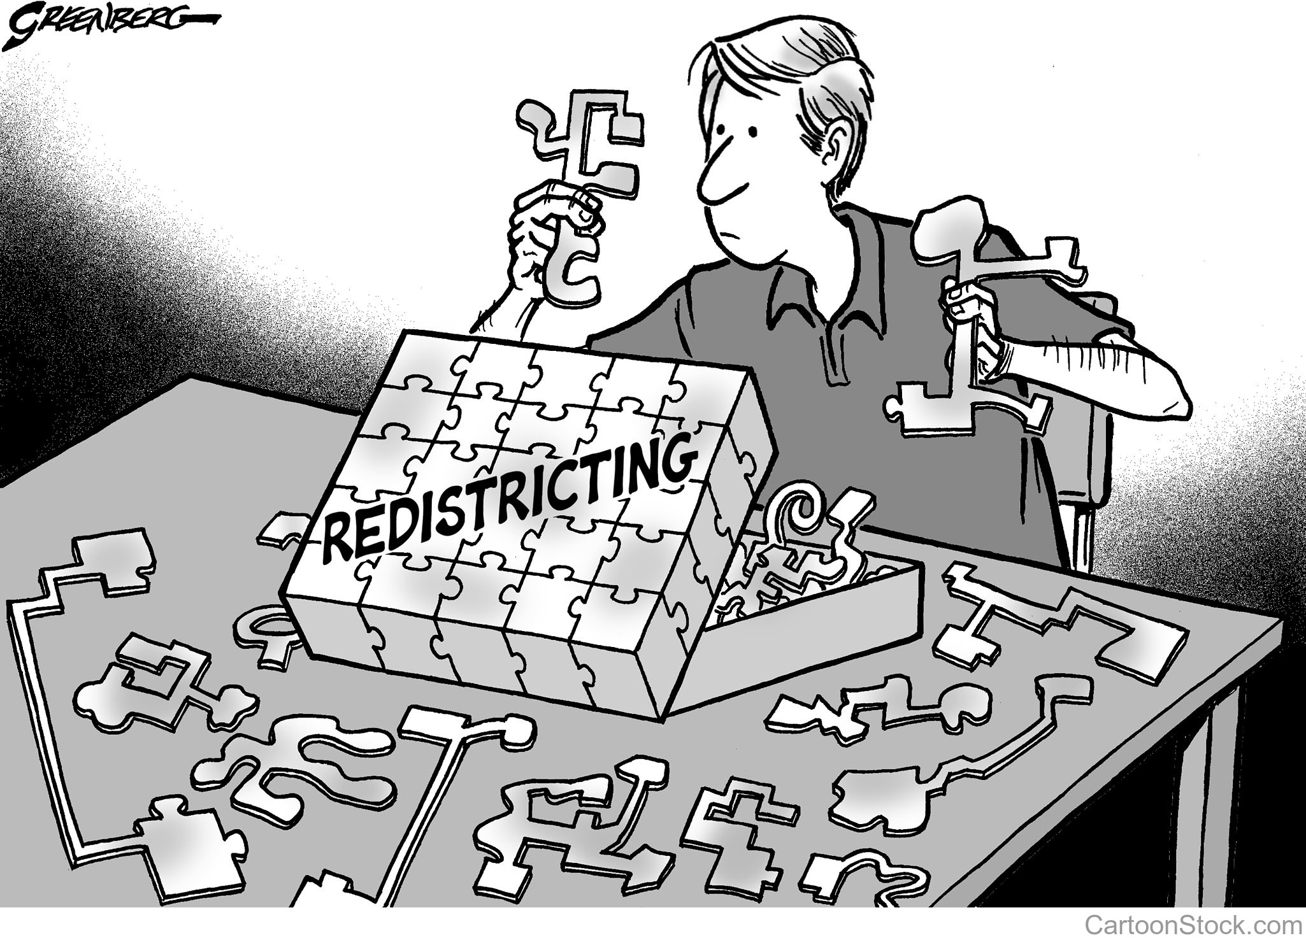
Redistricting
Notes:
So now lets turn to redistricting—which thankfully you shouldn’t have to wrestle with until 2021. But the road to it begins this year with the census.

Slide 21
2020 Census
Census Day-April 1, 2020
Notes:
Federal census population data is delivered to the legislature no later than April 1 of the year following the decennial census, and the data is usually provided several weeks earlier. As soon as the census data is verified and loaded in the computer systems, the members of the legislature and other interested parties begin drawing plans. Bills to enact new state redistricting plans follow the same path through the legislature as other legislation.

Slide 22
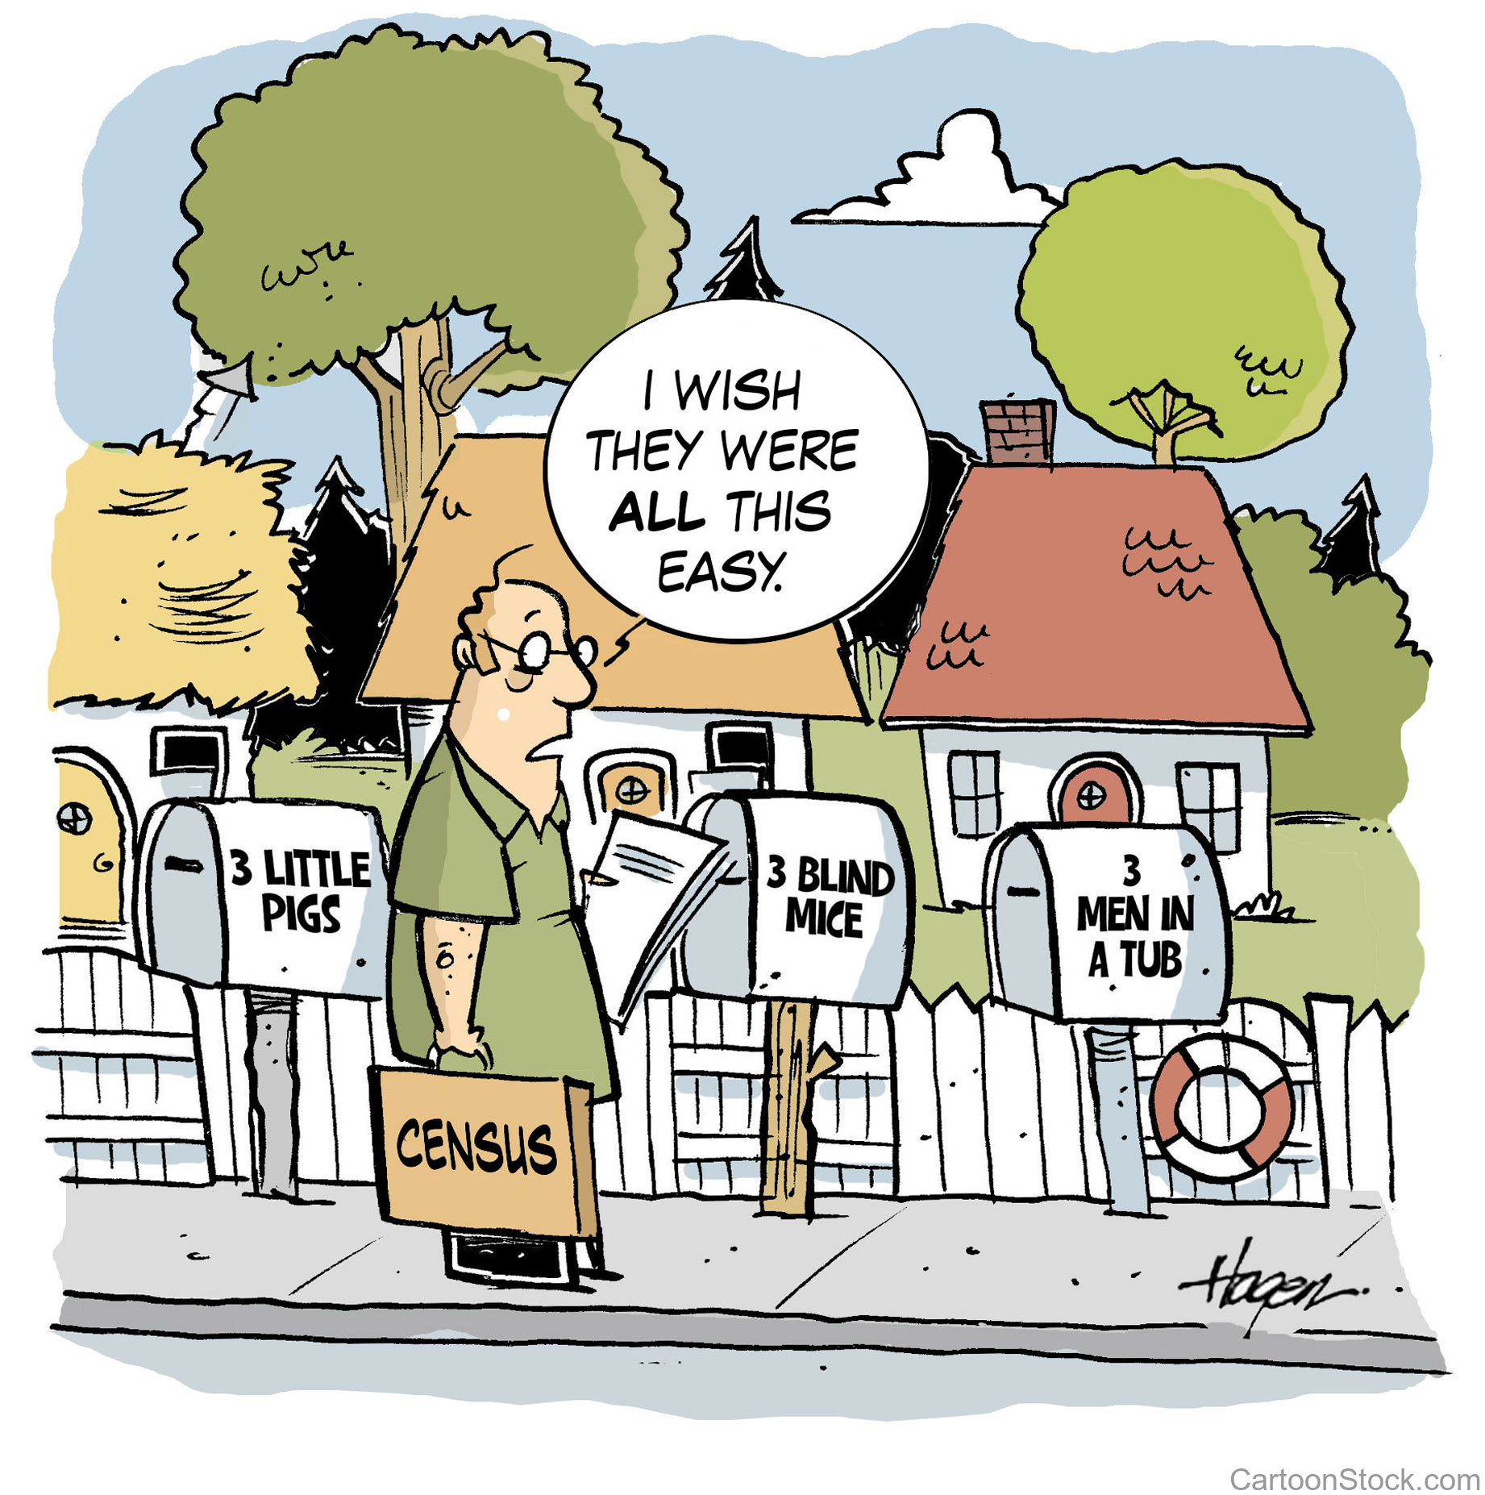
Notes:
So the legislature will draft and hopefully enact the new lines during the regular session---

Slide 23
Review population bracket requirements
Joint Clerks in county with population less than 8,000
Gov’t Code 51.501
Notes:
Sec. 51.501. JOINT CLERKS. (a) Except as otherwise provided by this section, a county with a population of less than 8,000 shall elect a single clerk to perform the duties of the district clerk and the county clerk.
(b) The offices of county clerk and district clerk may remain separate if a majority of the qualified voters in the county vote to keep the offices separate at an election held for that purpose. The commissioners court of the county may hold a special election for that purpose on a uniform election date authorized by law that occurs not later than the 30th day before the date of the regular primary election that precedes the expiration of the constitutional term of office for the clerk. Notice of the special election shall be published in a newspaper of general circulation in the county not later than the 20th day before the date scheduled for the election. The question may be presented to the voters again immediately before the expiration of each subsequent constitutional term of office of the separate clerk. The special election may not prevent a county clerk, district clerk, or joint clerk from serving the full term of office to which the clerk was elected.
(c) The commissioners court of a county that has a population of 5,800 to 5,900 shall determine whether the county shall have a joint clerk but may not take action to prevent a district clerk, county clerk, or joint clerk from serving the full term of office to which the clerk was elected.

Slide 24
Review population bracket requirements
In a primary election, the general election for state and county officers, or a special election to fill a vacancy in the legislature or in congress:
(1) the commissioners court of a county with a population of 400,000 or more shall establish one or more early voting polling places other than the main early voting polling place in each state representative district containing territory covered by the election, except that the polling place or places shall be established in the state senatorial or congressional district, as applicable, in a special election to fill a vacancy in the office of state senator or United States representative;
(2) the commissioners court of a county with a population of 120,000 or more but less than 400,000 shall establish one or more early voting polling places other than the main early voting polling place in each commissioners precinct containing territory covered by the election; and
(3) the commissioners court of a county with a population of 100,000 or more but less than 120,000 shall establish one or more early voting polling places as described by Subdivision (2) in each precinct for which the commissioners court receives in time to enable compliance with Section 85.067 a written request for that action submitted by at least 15 registered voters of that precinct.
Election Code § 85.062

Slide 25
Review population bracket requirements
Extended Early Voting Hours in county with population of 100,000 or more
Election Code 85.005
Extended Weekend hours in county with population of 100,000 or more
Election Code §85.006

Slide 26
Review population bracket requirements
Changes to the minimum number of registered voters in a county election precinct: Over 100,000 population, at least 100 but not more than 5000 voters. Under 100,000, minimum of 50 voters
In county with population under 50,000, minimum of 50 voters if court receives a petition signed by at least 25 registered voters of the precinct
Election Code §42.006

Slide 27
Review population bracket requirements
A county election precinct may not have territory inside a city with a population of 10,000 or more and unincorporated territory outside that city unless the commissioners court determines that either of the two areas:
(1) cannot constitute a separate election precinct of suitable size or shape that contains the permissible number of voters; or
(2) cannot be combined with other territory on the same side of the city boundary to form an election precinct of a suitable size or shape that contains the permissible number of voters without causing another election precinct to fail to meet those requirements.
Election Code §42.007

Slide 28
Legislative Redistricting
The Legislature shall, at its first regular session after the publication of each United States decennial census, apportion the state into senatorial and representative districts
Such apportionment shall become effective at the next succeeding statewide general election.
Notes:
They will be drawing the congressional districts, state senate, state representative and state board of education districts. If everything goes as planned the new lines would be effective for the 2022 election cycle.

Slide 29
Legislative Redistricting
allows approximately six and one-half months from the end of the regular legislative session for:
Filing deadline for primary elections
time for the Governor to act on legislation
for court action
for counties to make necessary changes in county election precincts.
Notes:
Here is where to discuss what happened in 2010 redistricting timeline.

Slide 30
County Redistricting
TEXAS CONSTITUTION art. 5, Sec. 18. DIVISION OF COUNTIES INTO PRECINCTS; JUSTICES OF THE PEACE AND CONSTABLES; COUNTY COMMISSIONERS AND COUNTY COMMISSIONERS COURT.
(a) Each county in the State . . . . according to the most recent federal census, from time to time, for the convenience of the people, shall be divided . . . A division or designation under this subsection shall be made by the Commissioners Court provided for by this Constitution.
Notes:
into not less than four and not more than eight precincts. Each county in the State with a population of 18,000 or more but less than 50,000, according to the most recent federal census, from time to time, for the convenience of the people, shall be divided into not less than two and not more than eight precincts. Each county in the State with a population of less than 18,000, according to the most recent federal census, from time to time, for the convenience of the people, shall be designated as a single precinct or, if the Commissioners Court determines that the county needs more than one precinct, shall be divided into not more than four precincts. Notwithstanding the population requirements of this subsection, Chambers County and Randall County, from time to time, for the convenience of the people, shall be divided into not less than two and not more than six precincts. A division or designation under this subsection shall be made by the Commissioners Court provided for by this Constitution.

Slide 31
County Redistricting
Before elections are held under the new districts, counties that are split by Congressional, legislative, or State Board of Education district boundaries under the newly adopted plans must change their voting precinct boundaries to conform with the new district lines.

Slide 32
County Redistricting
Changes necessary from legislative redistricting must be ordered by Commissioners Court before October 1 of the year in which the redistricting is done. Tex. Elec Code Sec. 42.032.

Slide 33
County Redistricting
Changes take effect on the first day of the even numbered year that follows the year the commissioners court ordered the change.
Tex. Elec. Code 42.033(a)

Slide 34
Voting Rights Act
Section 2-prohibits redistricting bills that dilute the votes of a state's racial and language minority citizens
Section 2 versus Section 5
5% variation between precinct population totals
Notes:
A suit challenging an adopted redistricting plan may be brought at any time under the federal or state constitution or federal law. Before 2013, Texas and certain other states were required to obtain federal preclearance of any redistricting plans before they could be implemented. In 2013, the applicable provision of the federal Voting Rights Act was held invalid by the U.S. Supreme Court.

Slide 35
Questions? Give us a ring!

